Slide 1
Prediction of outbreak of COVID-19
Kanak Kaushik
Student no. x18136966

Slide 2
Content
Motivation
Research Title
Literature Review
Methodology
Results
Discussion
Conclusion and Future Work

Slide 3
Motivation
Recent outbreak of COVID-19.
Precaution and prevention against pandemics.
To make people ready for the uncertain events.

Slide 4
Research Title
Forecasting and Analysis of COVID-19 Pandemic

Slide 5
Literature Review
Predictions models for epidemics
Susceptible, Infected, Recovered (SIR) model.
Nelder-Meade based Heurisitc model.
SVR and ANN.
Ensemble models like FW-reg-w.
Generalized Growth Model (GGM) and Generalized Logistic Model (GGL).
Prediction models for corona viruses
Susceptible-Exposed-Infected-Removed (SEIR) virus transmission model
ARIMA and ES
Generalized Logistic Growth Model (GLM)
Notes:
ARIMA explain numerical weather predictions has been used to determine the loads of certain areas
Downsized records into seasonal components
Palm opportunity which means that that the occasion takes place indefinitely,
Regression A regression model is used to investigate the relationship between two or more variables and estimate one variable based on the others.
Robust regression is an alternative to least squares regression when data is contaminated with outliers or influential observations and it can also be used for the purpose of detecting influential observations

Slide 6
Architecture
Data Extraction & Cleaning
EDA
Implementation of Models
Forecasting Model
Model Evaluation

Slide 7


Datasets
COVID-19 dataset by Johns-Hopkins University.
Datasets are divided in 80% and 20% proportion for training and testing by using test_train_split().
Notes:
Explain the datasets,
Preprocessing
All the columns explain

Slide 8
Methodology
A comparative model is designed to choose the best fit model.
Three algorithms namely Support Vector Regressor, Polynomial Regression, and Bayesian Ridge Regression are compared.
SVR(), LinearRegression(), BayesianRidge() functions are used to called from packages like scikit-learn package.
All these algorithms predicted the 10 days in advance then they are critically reviewed.

Slide 9
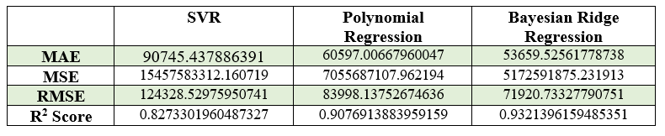
Result
SVR had the highest RMSE of 124328.5297 which is the least fit model.
BRR had the lowest RMSE and the R2 score being the closest to 1, which tells it is good fit model.
The RMSE, MAE, MSE, and R2 Score of the three forecast are:

Slide 10
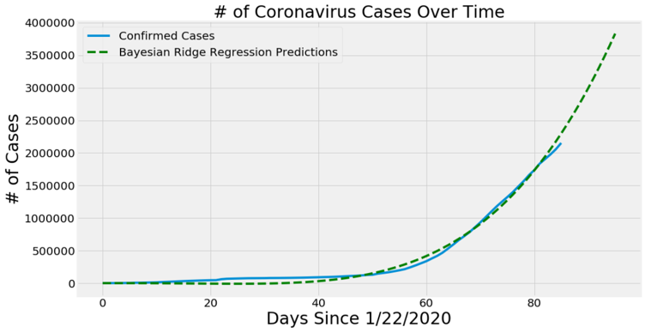
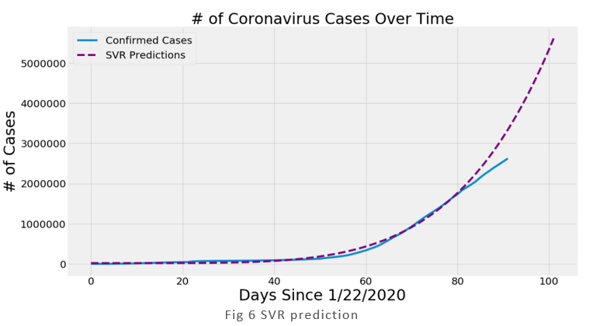
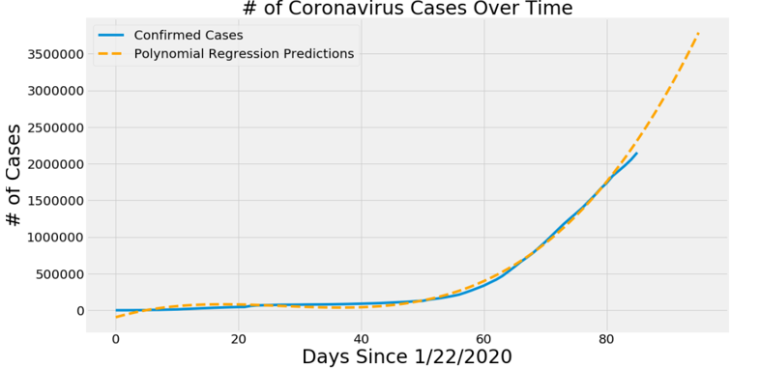
Prediction of models

Slide 11
Discussion
Forecasting any pandemics can be tough and the results may vary.
This research shows the performance of different models predicting the COVID-19 pandemic outbreak.

Slide 12
Conclusion and Future Work
Bayesian Ridge Regression model was found to be the best model for this dataset at this time.
Future Work:
The study can take into consideration of number of hospital beds available at the capacity.
Increase in the number of Healthcare professional and caretakers to include in the model.
People and Countries to be ready for the next pandemic.

Slide 13
Thank you

